Slide 1
A Data Based Approach to Choosing a College
DSBA 6100 Midterm Project
Patrick Brehm
Sneha Dingre
Vineeth Adithya Dodla
Abhilash Gandham
Shravani Reddy Kariveda
Yicheng Li
Nicholas Morris

Slide 2
Objective: Find the Perfect Fit for Maria
Determine a school or a group of schools that fit her requirements and preferences
Our approach: get a final dataset based on her requirements, then rank that dataset based on her preferences

Slide 3
Our Decision:
School: University of California- Los Angeles
Degree: Bachelor’s in Computer Science or MIS
UCLA had a max score of 10
Give Maria the option of 17 schools with a score greater than 5

Slide 4
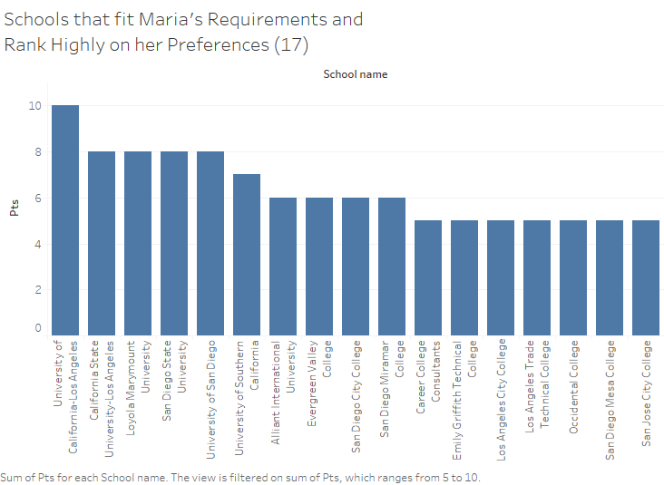

Slide 5
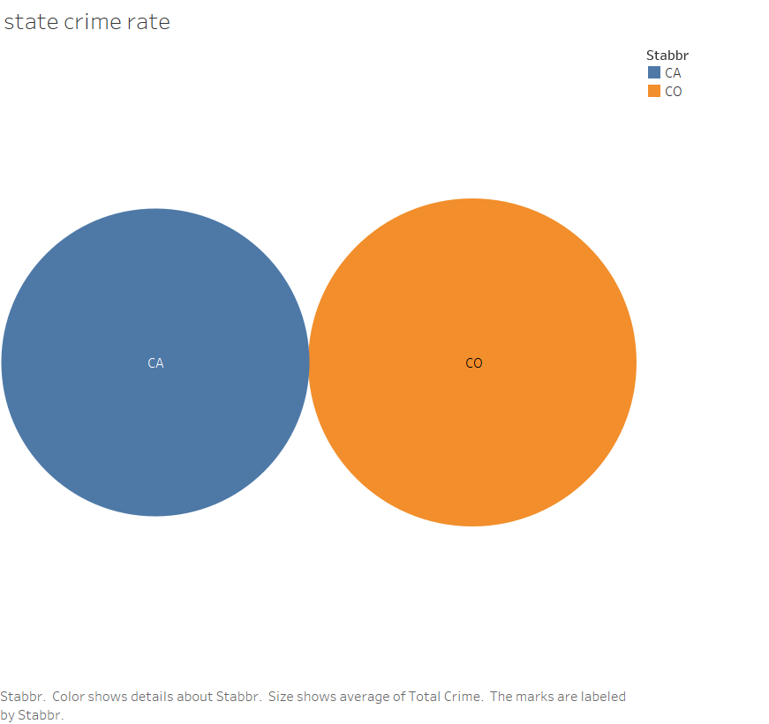
Notes:
California average crime rate: 2597
Colorado average crime rate: 2949

Slide 6
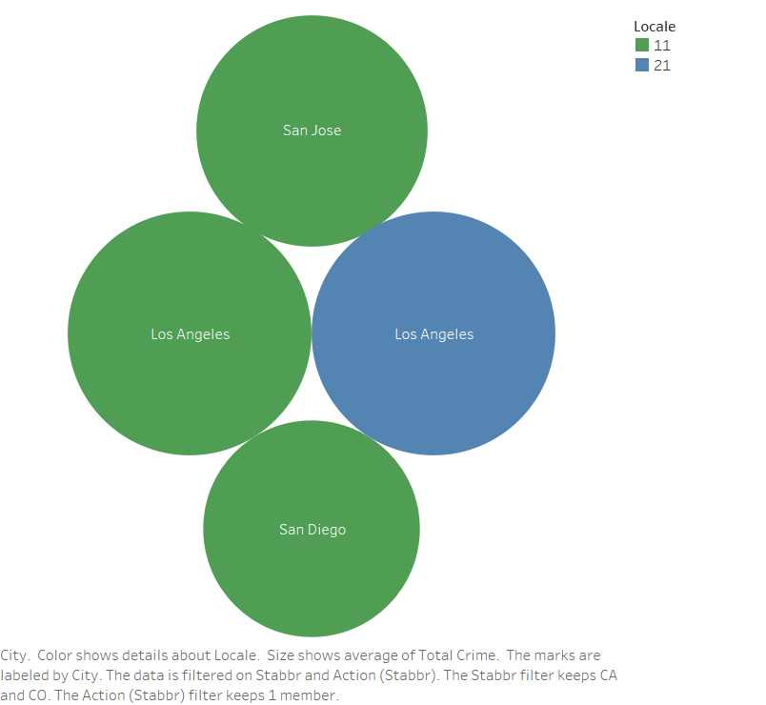

Slide 7
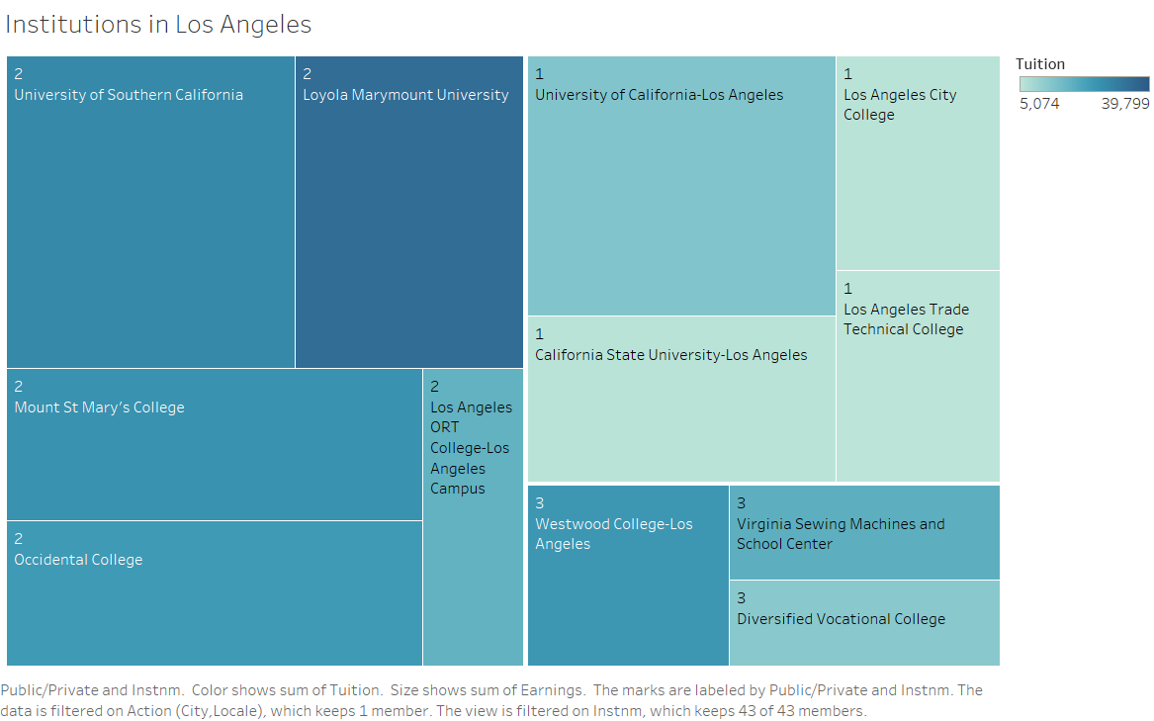

Slide 8
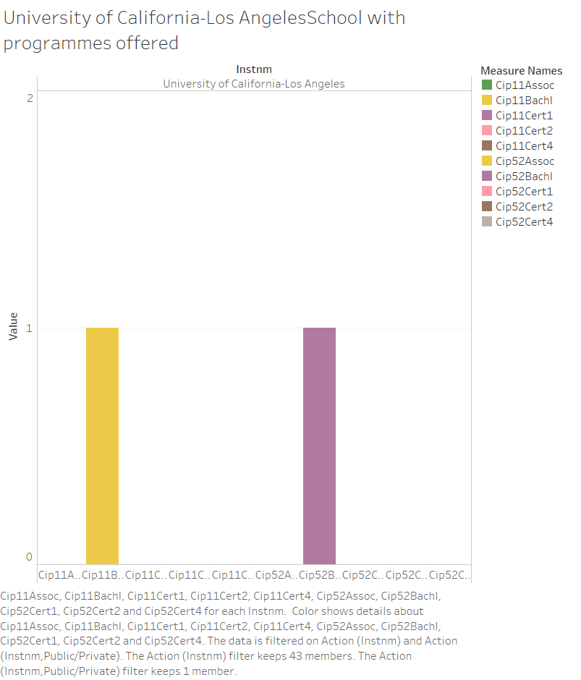

Slide 9
Maria’s School & Location Requirements
Safety
Urban Lifestyle
Opportunity
Preferred Program
Main Campus
Respected among academic community

Slide 10
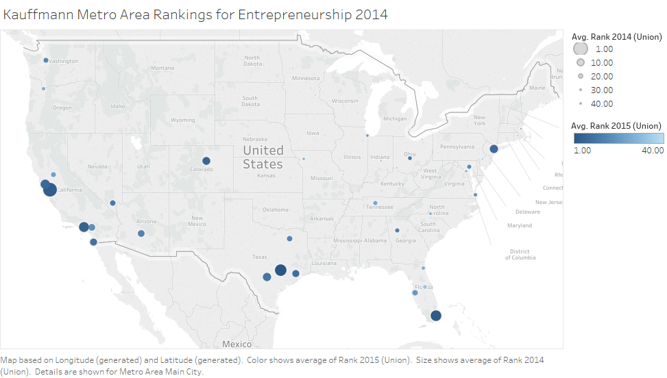

Slide 11
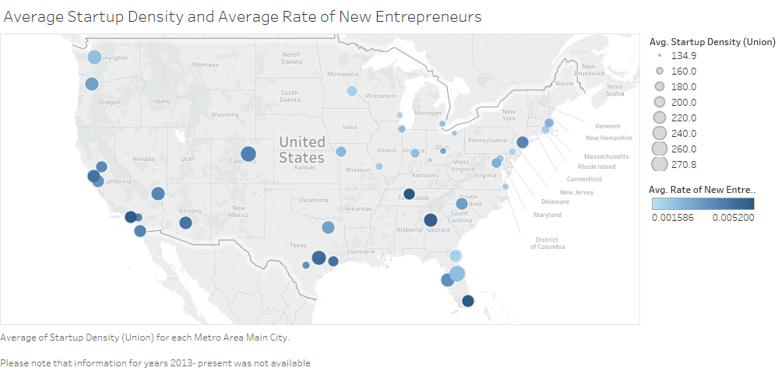

Slide 12
Our Approach
Consider safest 50% of cities based on Total Crime (Violent + Property)
Present options to live in a large city, a medium city, or a large city’s suburb
Filter to include top 25% of Kauffman Metro rankings for Entrepreneurship
Give Maria degree-level options for MIS, IT & Computer Science
Discard programs offered on auxiliary campuses
Eliminate non-accredited schools

Slide 13
Maria’s Preferences
Affordable tuition
Career potential
Public school
Academic support

Slide 14
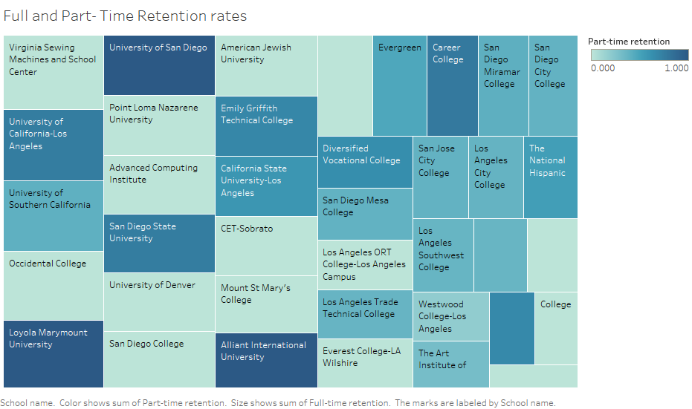

Slide 15
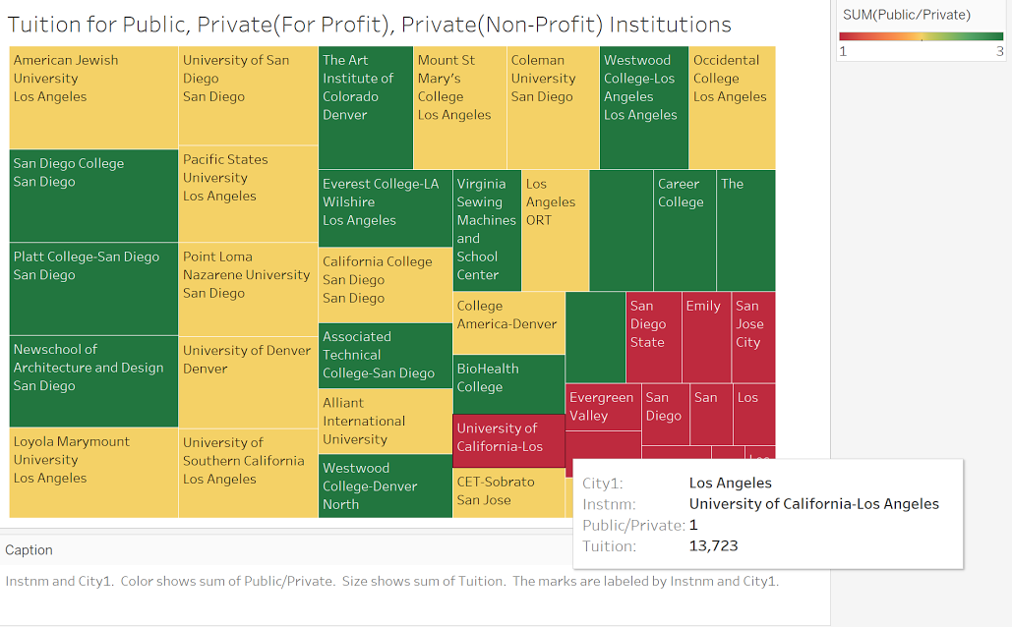

Slide 16
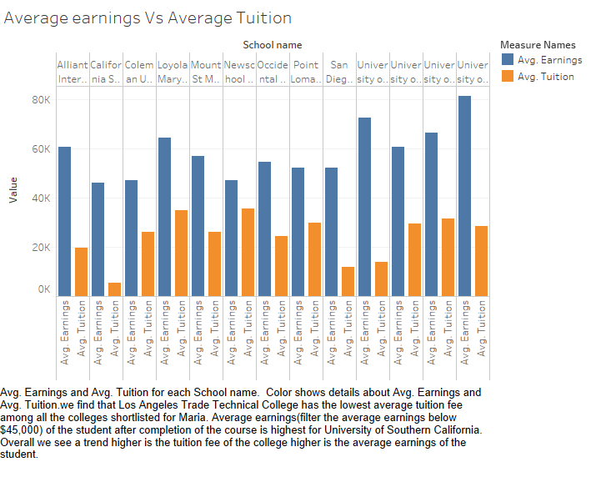
Notes:
Last 4: UCLA, University of Denver, University of San Diego, University of Southern California

Slide 17
Our Approach: Score Based
Affordable Tuition
3 points for top (cheapest) 10%, 2 for top 25%, 1 for top 50%
Earnings potential 10 years after graduation
3 points for top 10%, 2 for top 25%, 1 for top 50%
Notes:
Note: tuition cost used average cost
Prior working and military experience- top 25%

Slide 18
Our Approach: Score Based
Public or Private
1 point for Public schools, 0 for Private
Retention rates
3 points for top 10%, 2 for top 25%, 1 for top 50%
Notes:
Private indicates non-profit and for-profit
Retention rates considered for part time and full time, and 4 years or less than 4 years

Slide 19

UCLA had a perfect score based on our rankings
Best opportunity to succeed professionally and academically
Safe and fun lifestyle
We also wanted to give Maria other options
Major, Degree and Location

